Slide 1
The Rise of the Algorithm
Neil Lawrence
Amazon Research Cambridge
University of Sheffield
@lawrennd
Notes:
Challenges
Introduce self
Alphago impressive but requires heavy compute.
More games of go than any human
And yet still Lee managed to win a match.

Slide 2
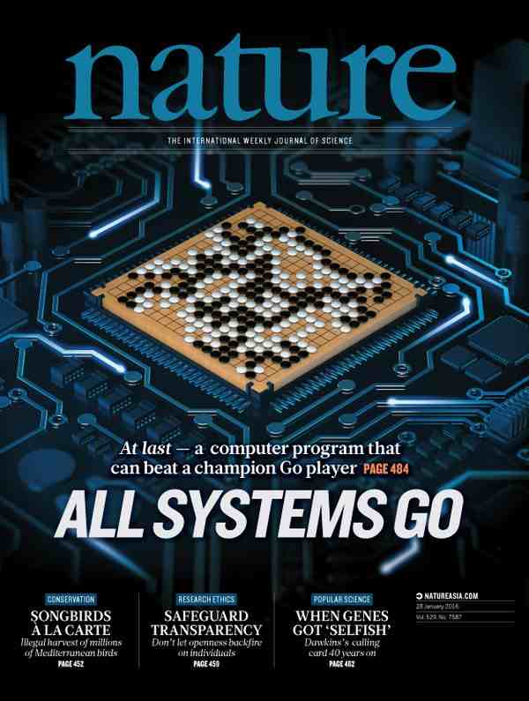

Slide 3

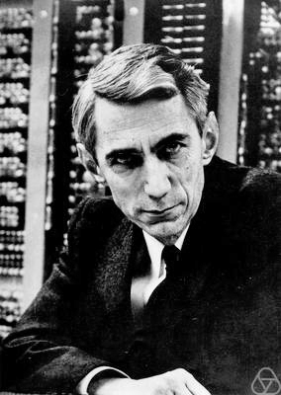

~10 gigaflops
10
~1 gigabit per second
~1000 teraflops?
$${10}^{13}$$
~100 bits per second?

Slide 4
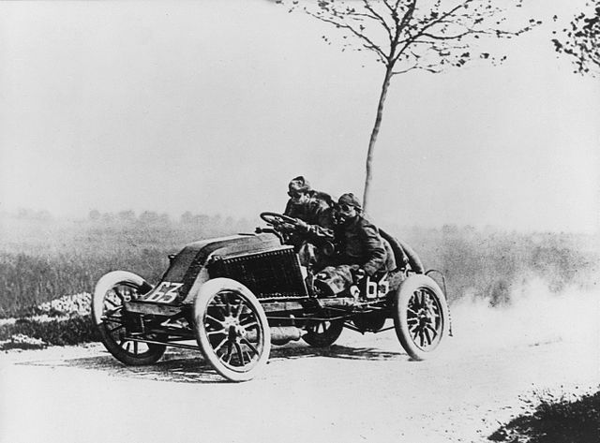

Slide 5
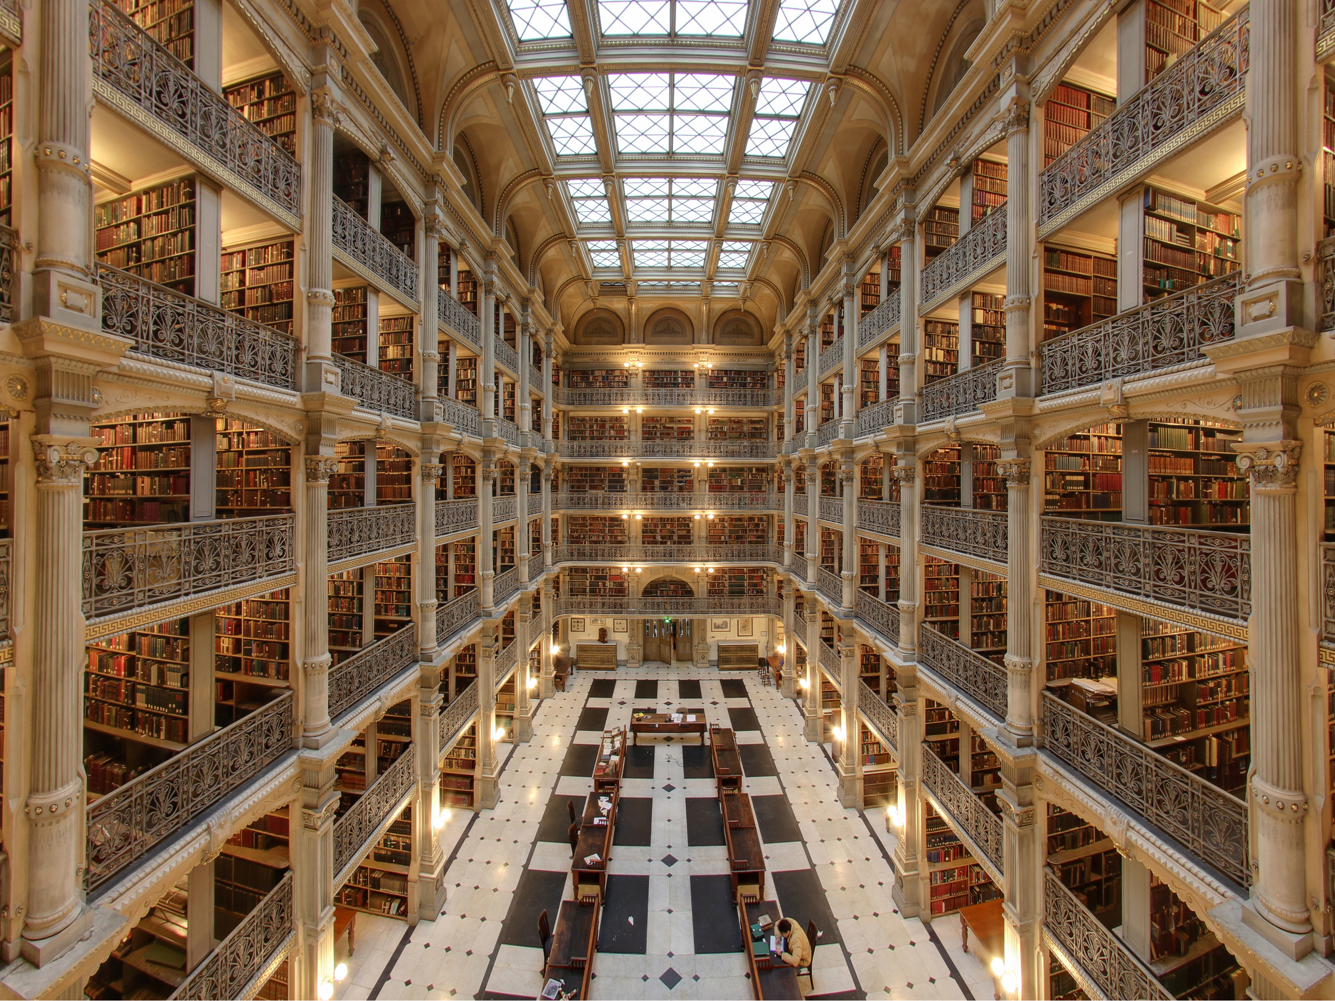

Slide 7
human
computer
data
high bandwidth

Slide 8


Slide 9


Slide 10
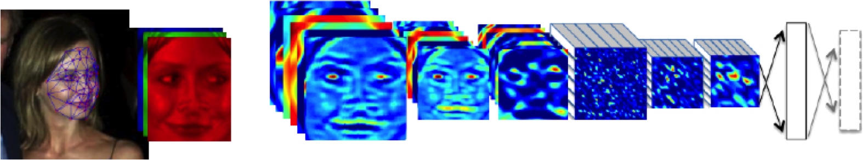

Slide 11











$\text{g}\left(x\right)$
${\text{f}}_{1}(x)$
${\text{f}}_{2}(∙)$
${\text{f}}_{3}(∙)$
${\text{f}}_{4}(∙)$
${\text{f}}_{5}(∙)$
${\text{f}}_{6}(∙)$
${\text{f}}_{7}(∙)$
${\text{f}}_{8}(∙)$
${\text{f}}_{9}(∙)$
$\text{g}\left(x\right)={\text{f}}_{9}({\text{f}}_{8}({\text{f}}_{7}({\text{f}}_{6}(⋯))))$

Slide 12





$x$
$$\text{ϕ}\left({\text{W}}_{1}x_{1}\right)$$
$$\text{ϕ}\left({\text{W}}_{2}h_{1}\right)$$
$$\text{ϕ}\left({\text{W}}_{3}h_{2}\right)$$
$$y$$
Yes
No

Slide 13
$x$
$$\text{ϕ}\left({\text{W}}_{1}x_{1}\right)$$
$$\text{ϕ}\left({\text{W}}_{2}h_{1}\right)$$
$$\text{ϕ}\left({\text{W}}_{3}h_{2}\right)$$
$$y$$
Yes
No

Slide 14
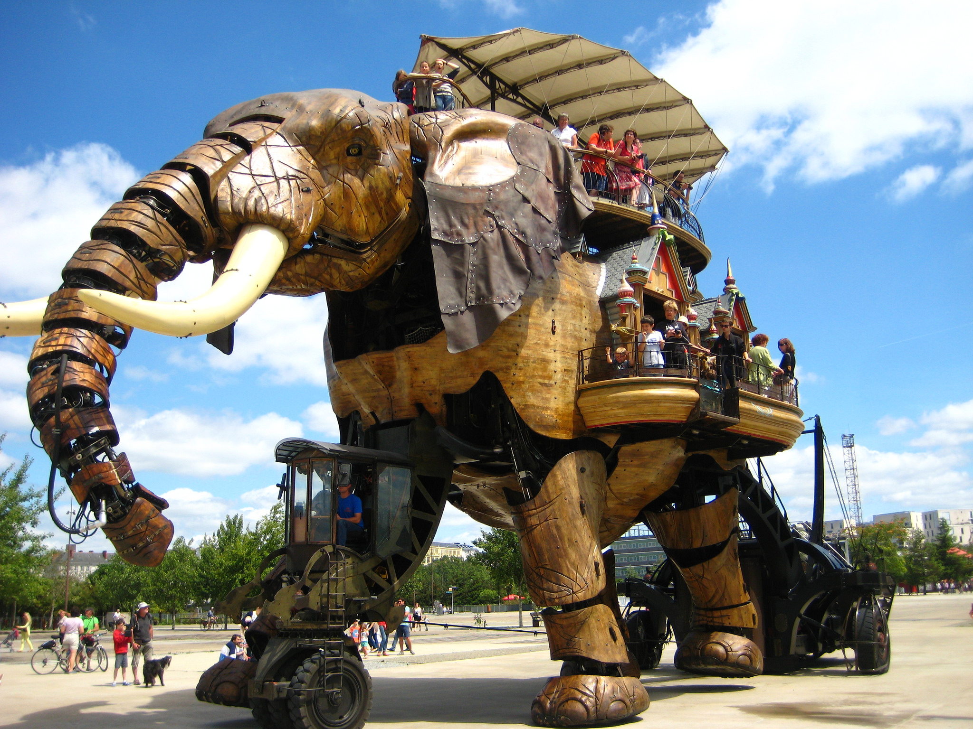

Slide 15
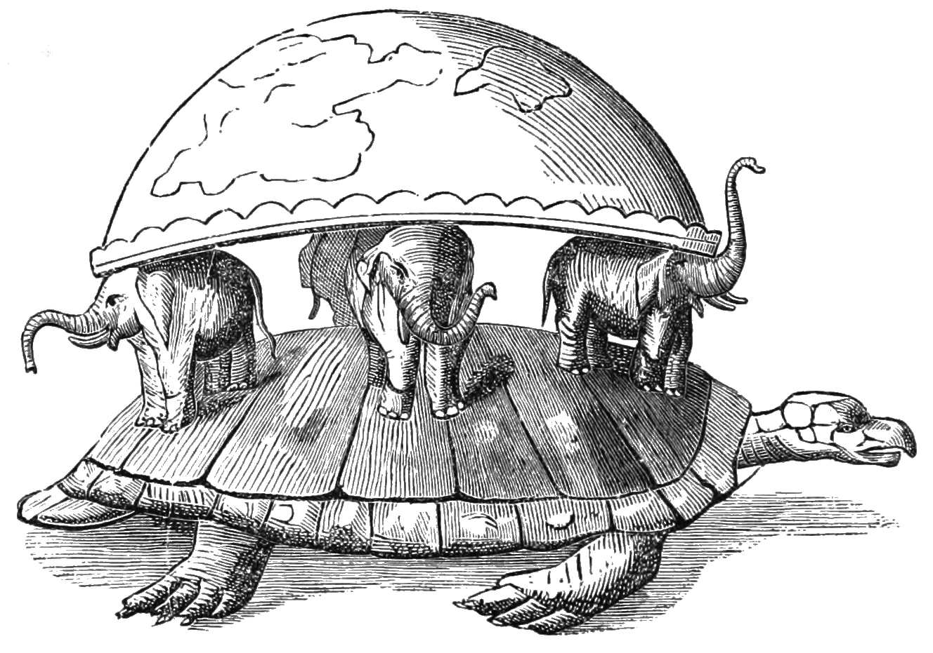

Slide 16
!
?
?
!

Slide 17
#
#!@?!
?
?
%@!!?
!

Slide 18
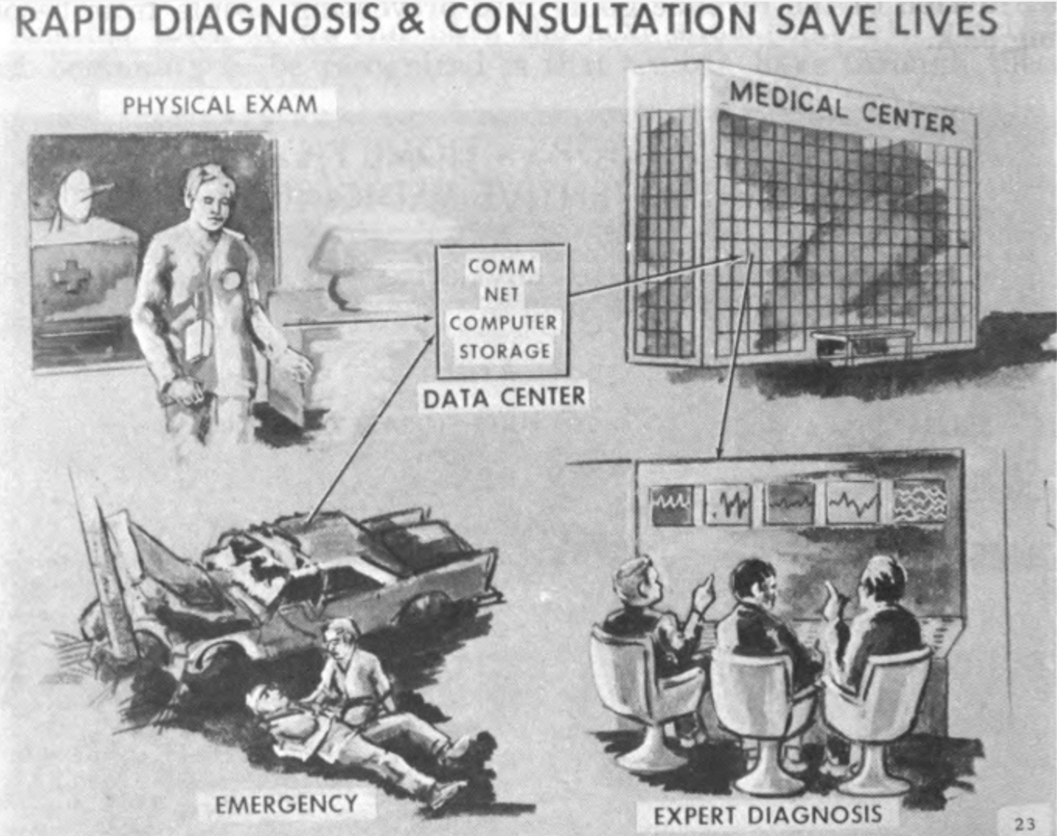

Slide 19
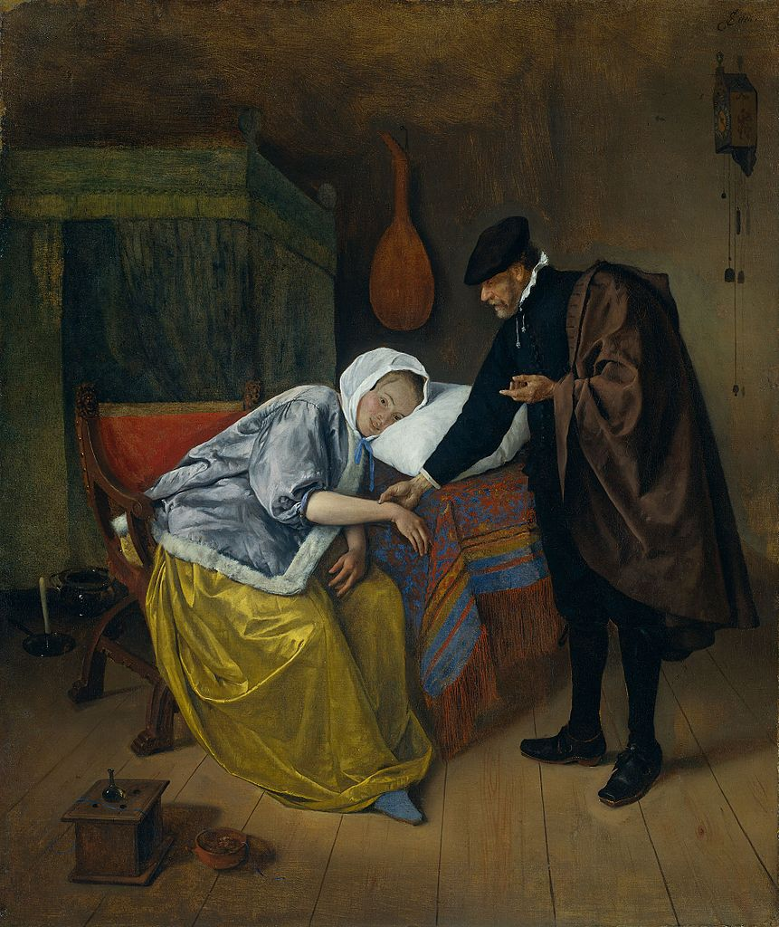
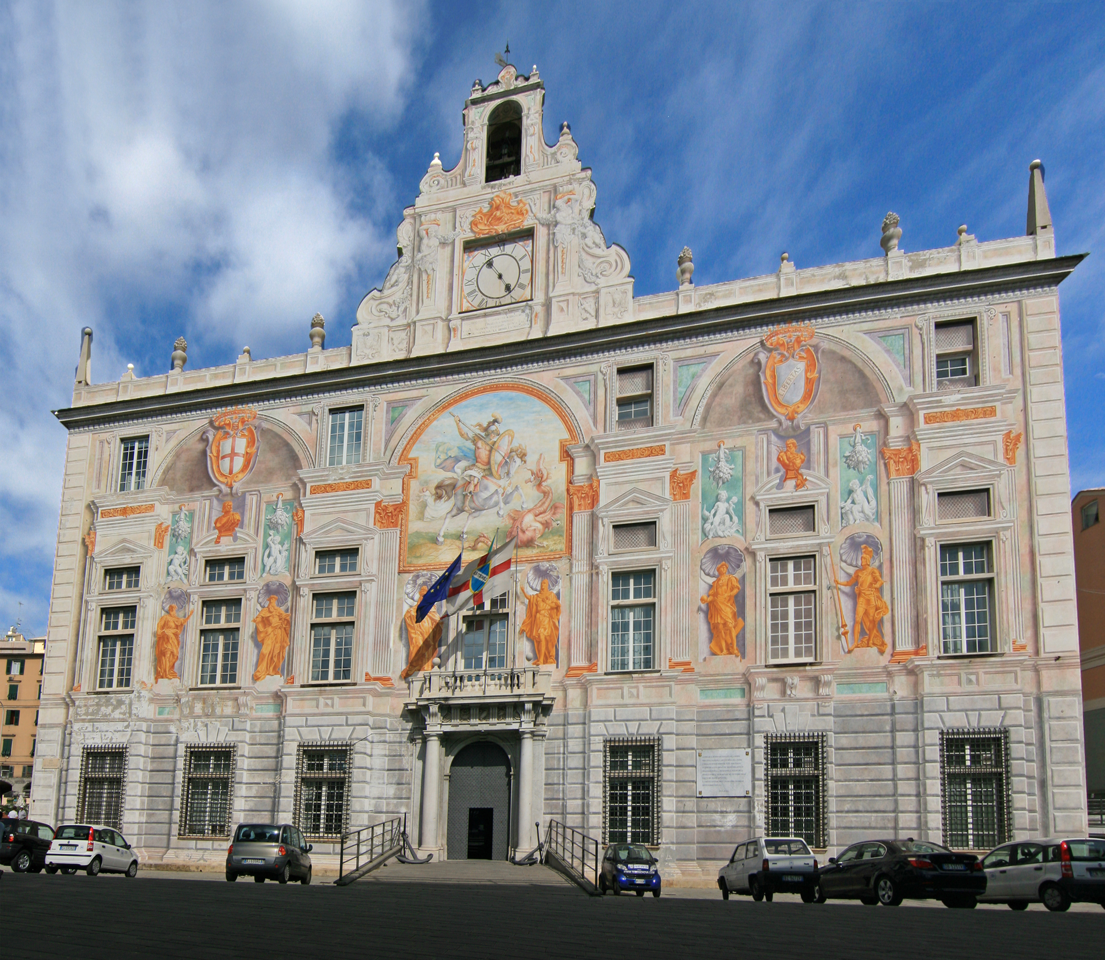

Slide 20


Slide 21
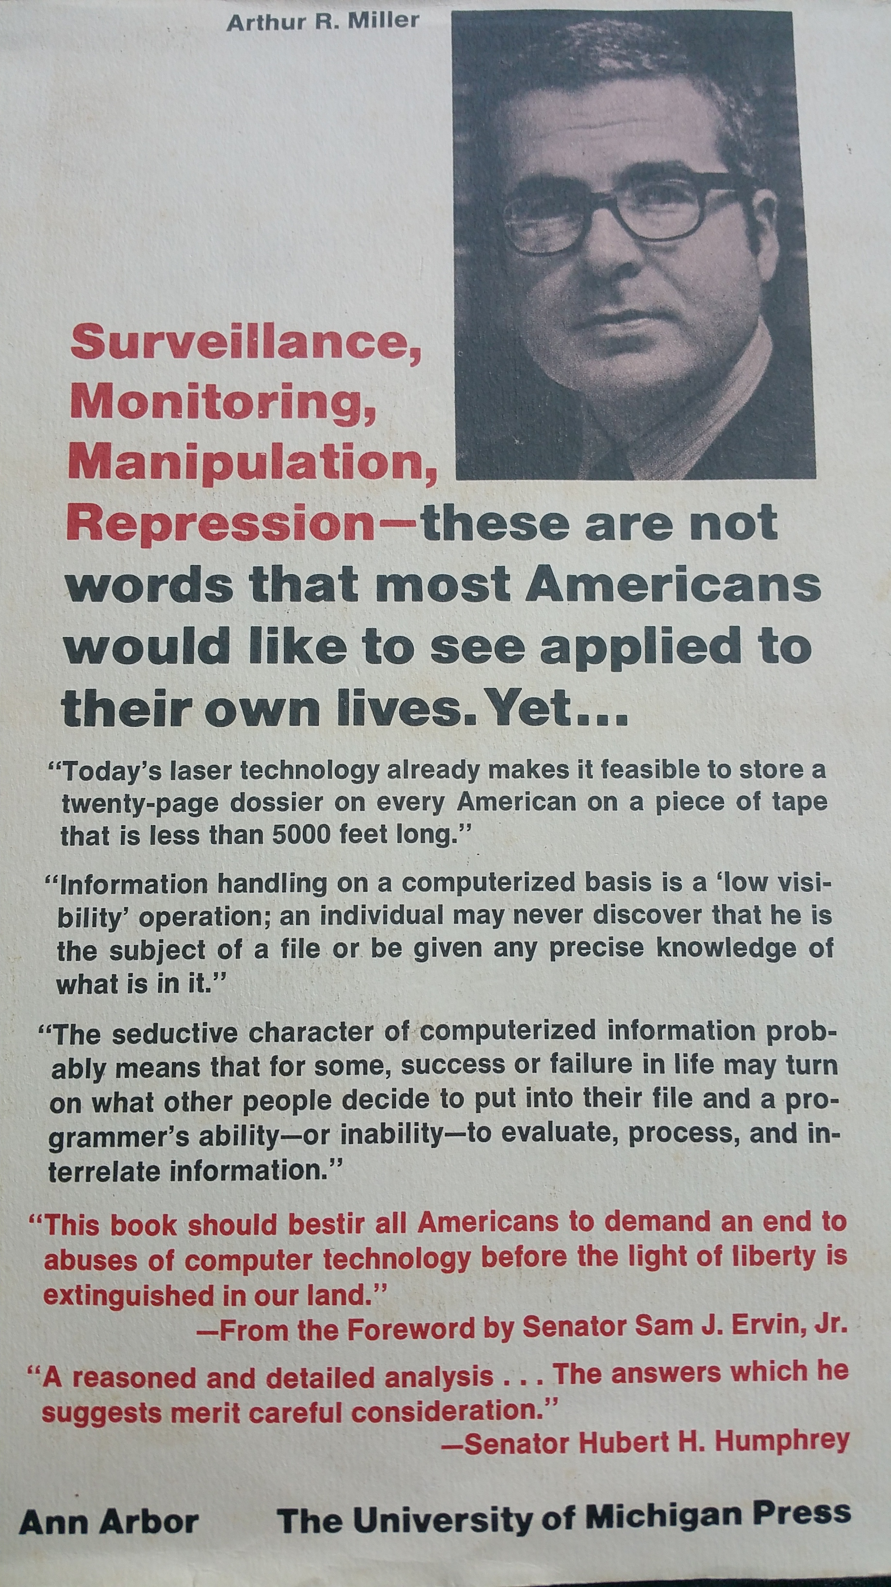

Slide 22
Thank you
Neil Lawrence
http://inverseprobability.com
@lawrennd
Notes:
Thank you.

